Slide 1
TEAM A
BUS TRACKING SYSTEM REPORT
Date : 28 October, 2023
Johri Aniket Manish
Jaimin Viramgama
Sayan Kundu

Slide 2
Overview:
This progress report is being submitted to update stakeholders and team members on the current status of the project. The report covers the progress made during the period of 21-10-23 to 27-10-23.

Slide 3
Progress Made:
During this period, the project team made significant progress towards achieving the project's objectives. The following tasks were completed:
- Completed research on NavIC.
- Attended the Hardware and Software Session.
- Written the Documentation of NavIC by each team member.
- Feedback collected from 450 students about the existing app present.
- Documented all the feedbacks.
- GitHub Repo is updated frequently regarding the progresses we have made.
- Created the architecture of the project.
- Created a detailed Figma Design on the website we are going to implement.

Slide 4
System Architecture:
Our team has worked diligently on defining the system architecture, which forms the foundation of our Bus Tracking System.
We have identified the key components of the system, including the user interface, database, server, and communication infrastructure.
We have also chosen the technology stack for each component, ensuring scalability, security, and reliability.

Slide 5
Figma Design:
We have created a comprehensive design prototype using Figma, which showcases the user interface of the application.
This design includes key features such as the bus tracking map, user login, registration screens, and real-time bus location updates.

Slide 6
Challenges Faced:
Despite the progress made, the project team faced the following challenges during this period:
- Limited availability of key personnel due to other commitments.
- One of the team members is not given the permission to edit the excel sheet (progress report) provided to us.

Slide 7
Next Steps:
Moving forward, the project team plans to take the following steps:
- Finalize the design on Figma and start with the programming.
- Schedule a meeting with concerned authority to discuss the report findings and recommendations on the architecture.
- Prepare for the next phase of the project, which involves starting with the programming portion of the project (Development of web-application).

Slide 8
FIGMA DESIGNS

Slide 9
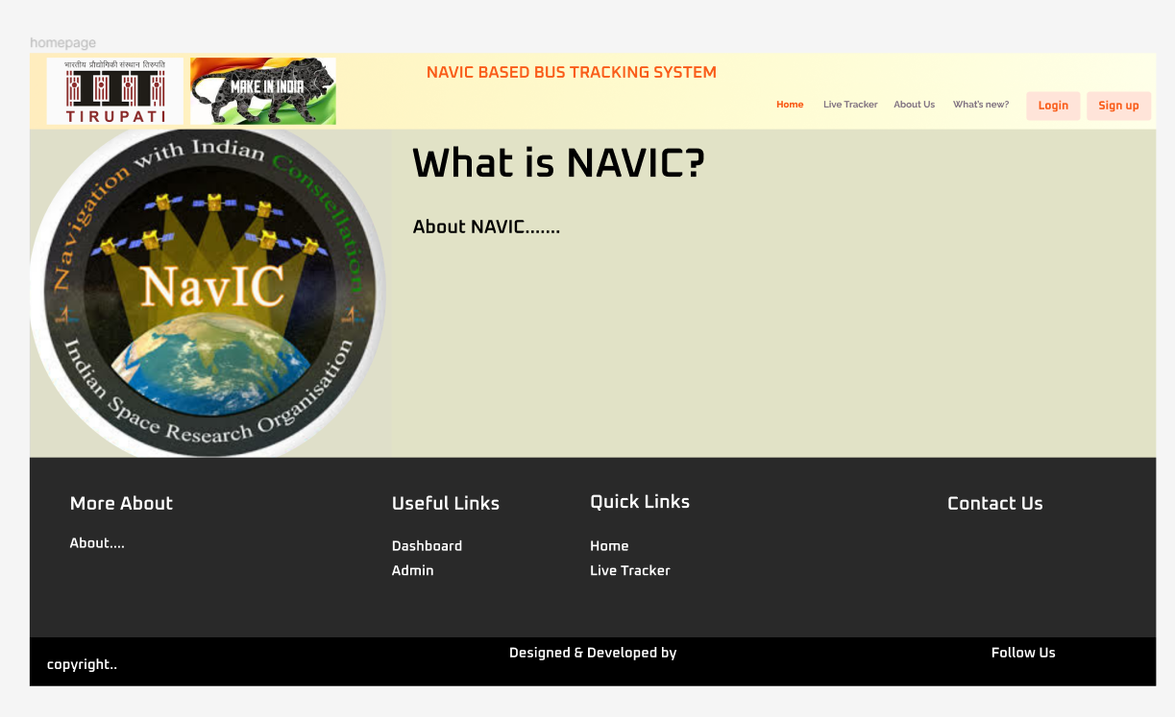
Homepage

Slide 10
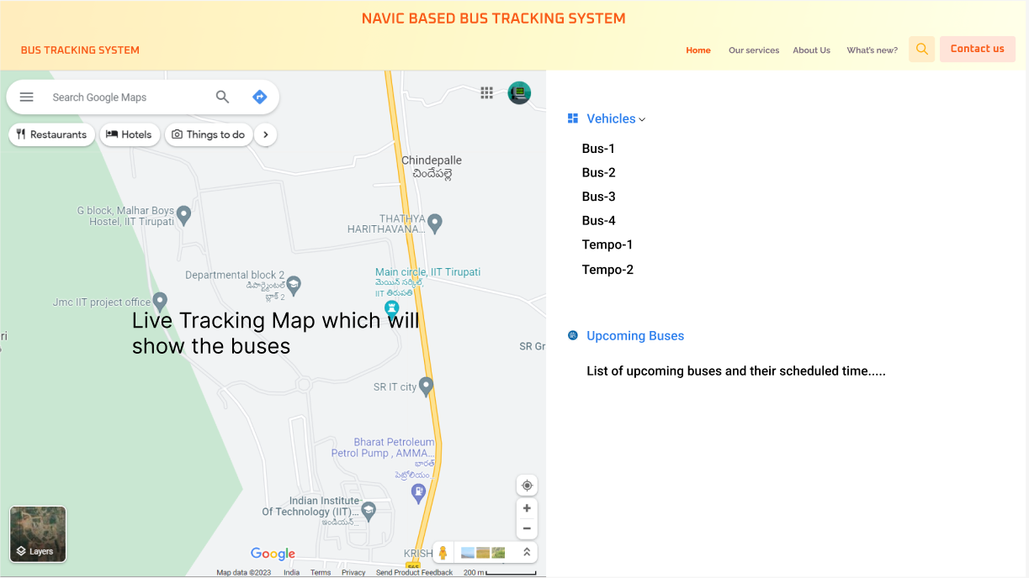
Live Tracker

Slide 11
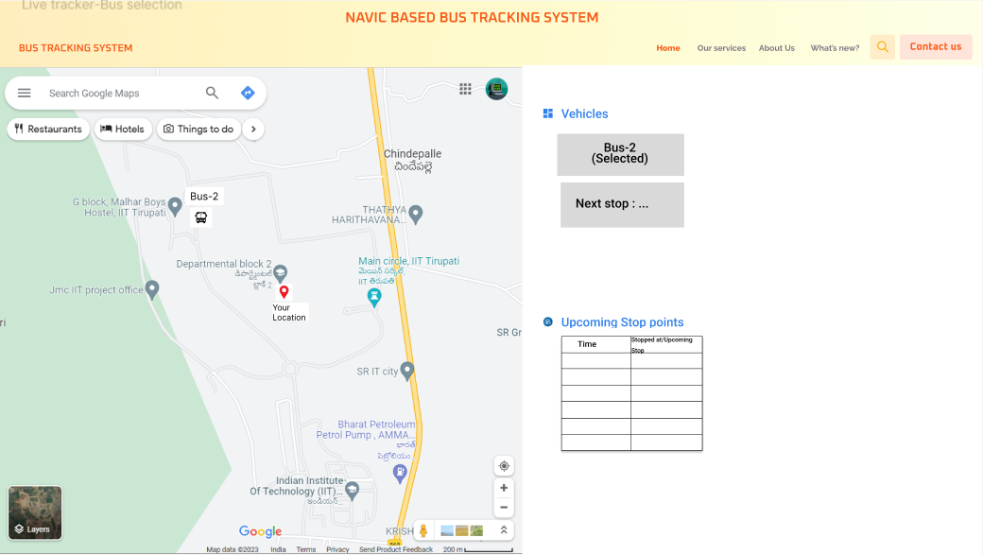
Live Tracker-Bus Specification

Slide 12
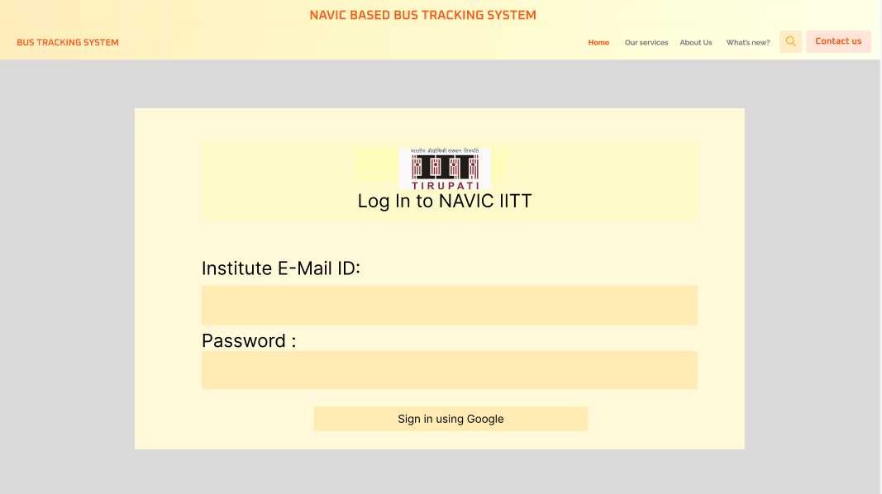
Login Page

Slide 13
Conclusion:
Overall, the project is progressing well, despite the challenges faced during this period. Team A remains committed to achieving the project's objectives and delivering a high-quality outcome.

